Slide 1
Geometric algorithms for conformational analysis of protein loops
J.Cortes, T.Simeon, M. Remaud-Simeon,V. Tran
Presented by Vera Vsevolozhsky
Notes:
נציג מאמר שנותן פתרון אנליטי למקרה מיוחד של בעיית סגירת הלופים.

Slide 2
Agenda
Introduction and Motivation
Problem Formulation
Conformational sampling
Conformational Space Exploration
Results
Conclusions
Prospects

Slide 3
Introduction-outline
Protein secondary structure
Protein loop structure
Loop closure and steric clashes
Loop closure/clash filtering approaches
Analogy to Robotics

Slide 4
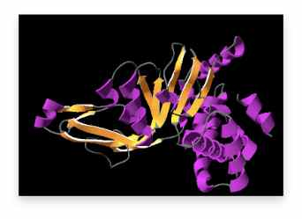
Protein secondary structure
loops
loops
beta-sheet
beta-sheet
alpha-helices
alpha-helices

Slide 5
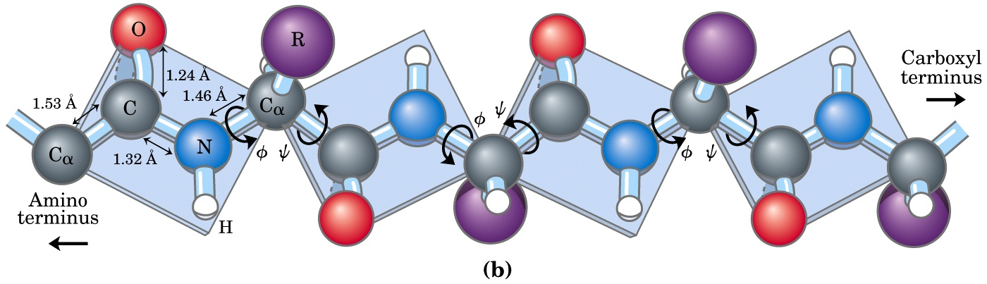
Protein loop structure
Backbone chain
Side chains (R)
Constants : bond lengths, bond angles
Variables : dihedral angle

Slide 6
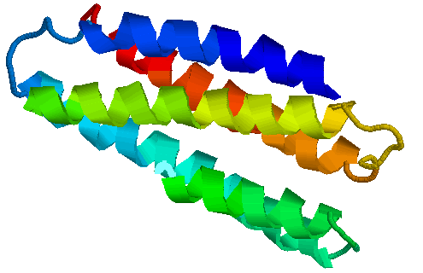
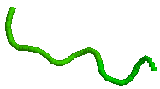
Loop closure
The first and last atoms of the treated segment of a molecular chain must remain bonded with their neighbor atoms

Slide 7
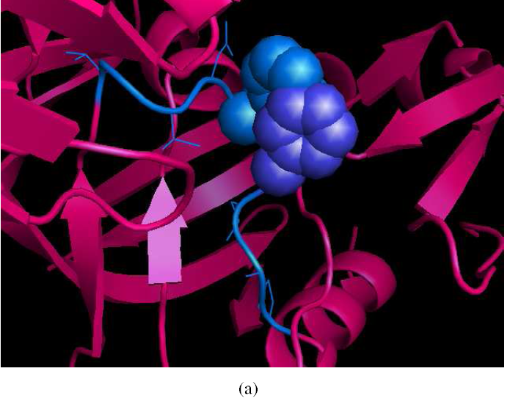
Steric clash
Distance(Atom1, Atom2) > Sum van der Waals radii of (Atom1, Atom2)
Example of clashes between 2 side-chains in 1MPP
Self-clashes and Internal clashes are forbidden

Slide 8
Loop modelling approaches
Ab initio loop prediction
-Conformational search for minimum energy structures (simulating annealing, gradient decent)
Database approach to loop prediction

Slide 9
Loop Closure Approaches(1)
Analytical – inverse kinematics
-Wedemeyer and Scheraga(1999) solution for tripeptides with 6 degree of freedom, etc.
Database based methods
Difficulty increases with the length of the molecular chain

Slide 10

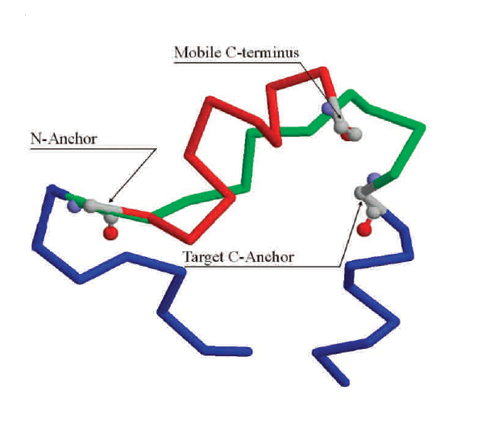
Loop Closure Approaches(2)
Optimization – e.g. CCD
Difficulty increases with the length of the molecular chain

Slide 11
Clash Filtering Approaches
Energetic – accepting/rejecting a conformation according to some energetic
(repulsive VdW energy) cutoff
Geometric – “clash grids”
The higher the number of atoms more critical efficiency

Slide 12
In Robotics – motion planning
Collision with obstacles/self-collisions are forbidden
For kinematic loops - closure constrains exists
Exploration of the conformations space, searching for feasible conformations
Sampling-based techniques capture the topology of the feasible space within a data-structure (graph or a tree) by performing random exploration

Slide 13
Motivation
Filter unfeasible loop conformations to aid searching conformational space for various application:
- Protein loop modeling
- Molecular simulations: conformational changes under environmental conditions

Slide 14
Problem formulation - outline
Geometric Model of the molecule
Geometric Constraints

Slide 15
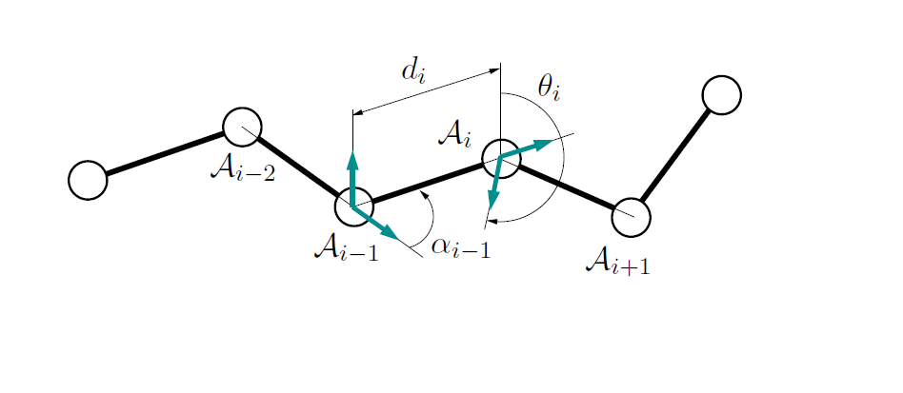








Geometric Model: Molecular chain model
Molecules –
Bond length, ,between
Bond angle, ,between
Dihedral angle, ,formed by

Slide 16
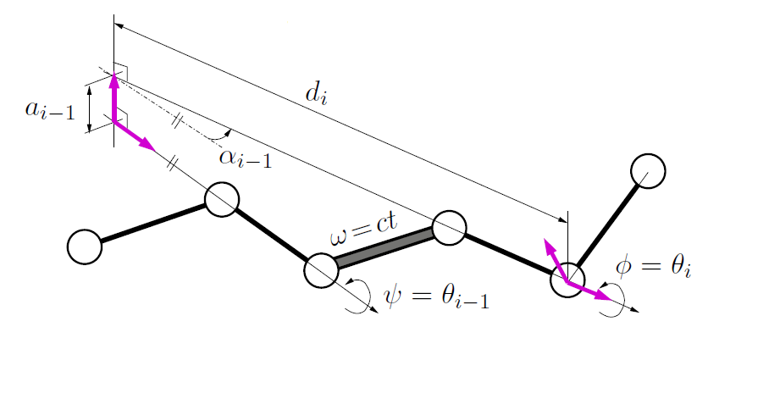
Geometric Model: Articulated mechanism
We assume that only dihedral angles are variable parameters (rigid geometry)

Slide 17
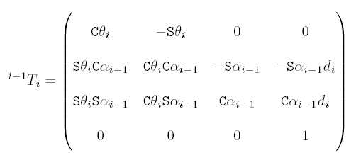
The Homogeneous Transformation Matrix
We defines the relative location of consecutive frames as follows:
All parameters as in Molecular chain model that was defined previously
S - sinus
C - cosines

Slide 18

Geometric Constraints
Loop Closure
Clash avoidance(70% of VdW radii)
(Condition must be satisfied between atoms of the articulated segment and between atoms of the rest of the molecule)

Slide 19
Conformational Sampling - outline
Random Loop Conformation
Backbone Conformation with closure
Loop decomposition
RLG algorithm
RLG Algorithm: example
Clashes and Side-Chain Conformation

Slide 20
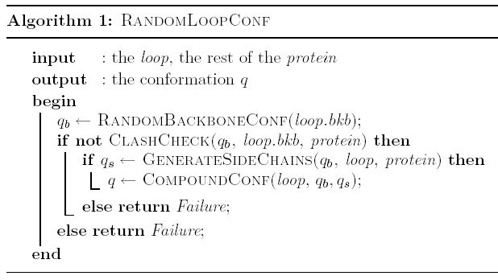
Random Loop Conformation
Compute random conformation achieving loop-closure and clash avoidance constraints in 3D.
Array of dihedral angles: θ₁,θ₂,…θ_{n}
A generic 3D collision detection algorithm (T. Siméon, C. van Geem, 2001)
Sample angles randomly at random side-chain order. Check for clashes
Notes:
Q_a-active variables
Q_p-passive variables

Slide 21
Solving multivariable non-linear algebraic equations
No efficient general solution exists
Known – 6 variables are dependent
How to obtain independent variables satisfy closure equations?

Slide 22
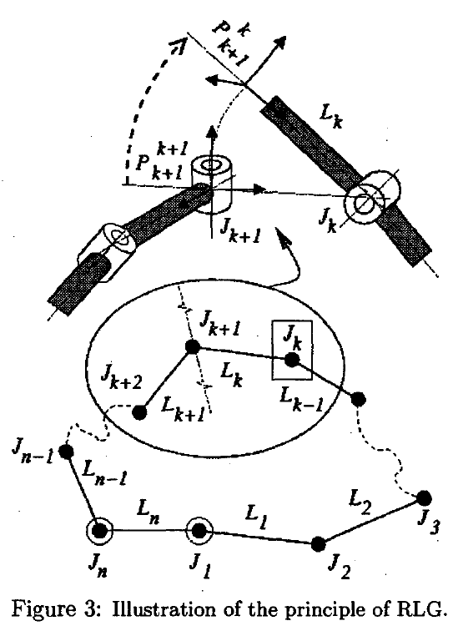


Random Loop Generator (RLG)
Closure interval of Jk - values of Jk that make possible
to close the mechanism are the ones for which
is reachable (in position and orientation) by the chain
_{Passive chain}
_{Active chain}

Slide 23
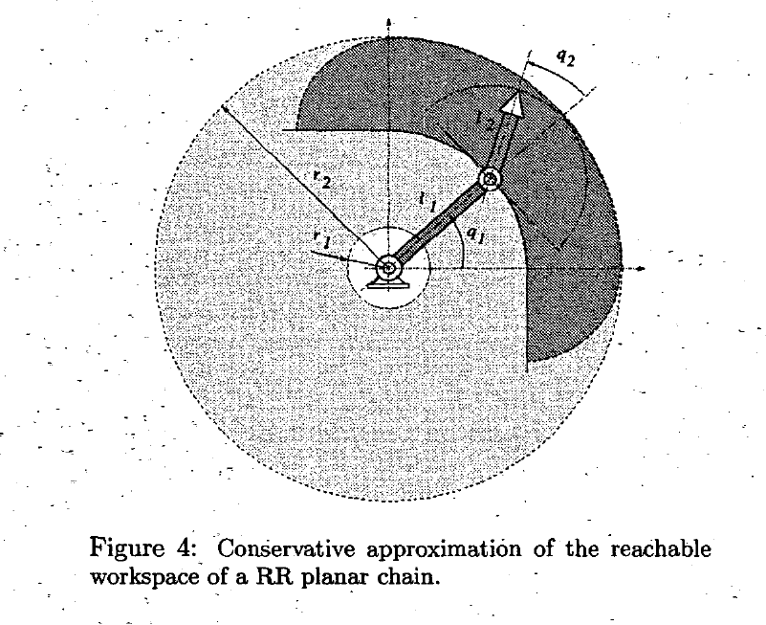
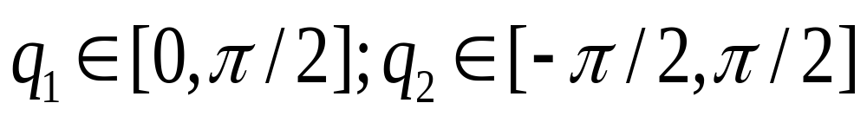
RLG: Approximated reachable Workspace
_{Reachable}
_{workspace}

Slide 24
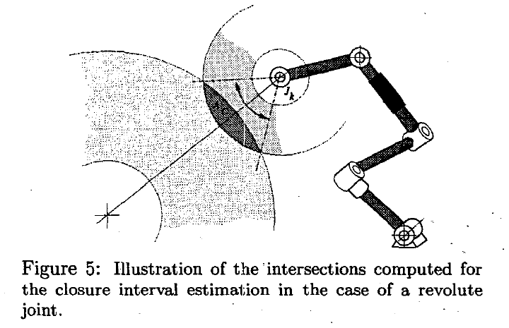
RLG: Closure Interval Computation
_{Closure interval of Jk}

Slide 25
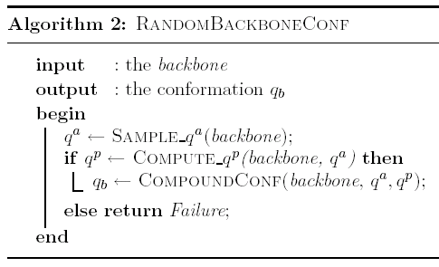
RLG Algorithm
A standard inverse kinematics problem
Compute
configuration
parameters
of active sub-chain

Slide 26
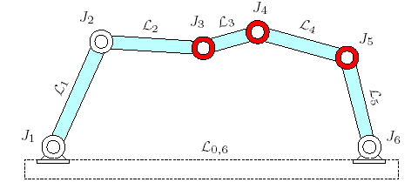

Loop decomposition-6R planar linkage
Passive sub-chain: dependent variables J₃, J₄, J₅. (Corresponding to three residues and six dihedral angles)
Active sub-chain: independent variables J₁, J₂, J_{6.}
Closed Loop
Notes:
L-rigid bodies
J-revolute joints

Slide 27
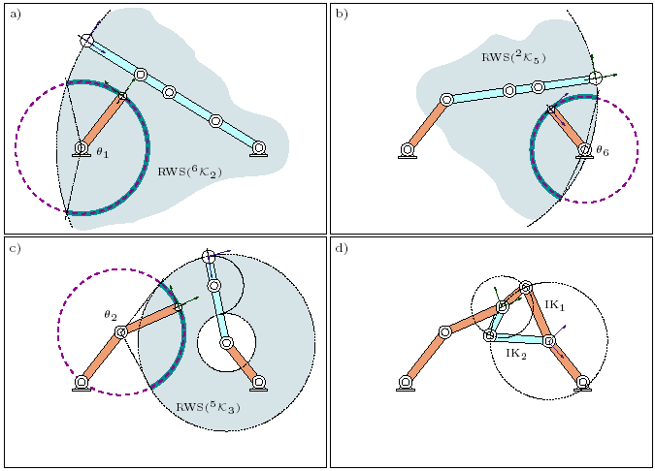
RLG Algorithm: example
Reachable WorkSpace of Chain6-2
Closure Interval of θ₁
→ Solving the positional-reachable problem is simple and fast approximation to the exact closure range

Slide 28
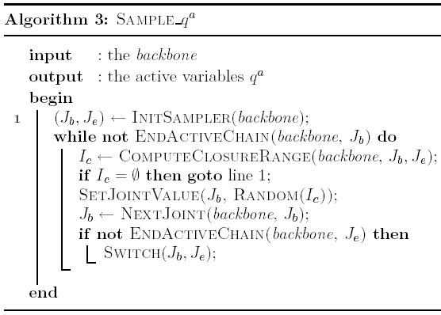
RLG Algorithm: Backbone Generation

Slide 29
Sampling side-chain conformation
Built upon a feasible backbone conformation
Generated by randomly sampled dihedral angles
Tested for collisions
Only the conformation of clashing side-chains is resampled

Slide 30
Conformational Space Exploration - outline
Sampling-based Motion Planning Techniques
RTT Algorithm

Slide 31
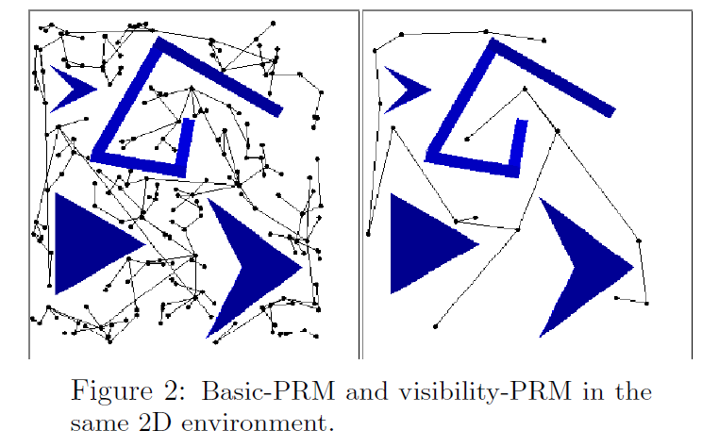
Probabilistic RoadMap(PRM) principle
Graph (roadmap) captures the topology of collision-free configuration
Nodes are randomly sampled
Edges are short feasible paths linking “nearby” nodes

Slide 32
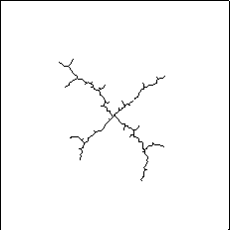
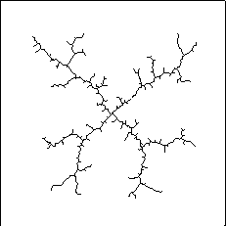
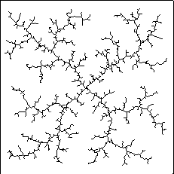
Rapidly Exploring Random Tree (RRT) developed by M.LaValle and J.Kuffner
Properties:
Expands quickly
Unbiased relative to random walk.
Vertices are uniformly distributed
Short paths
Quickly searches high-dimensional spaces

Slide 33
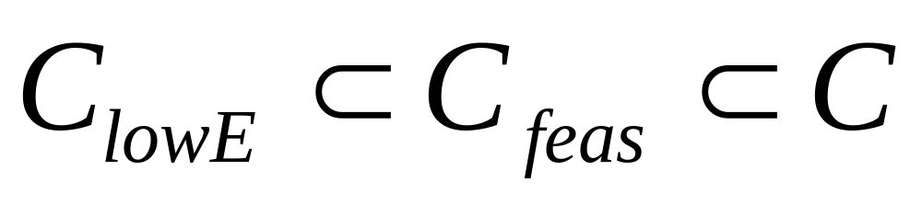
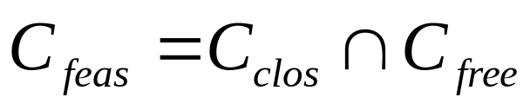
We search for….
Assumption: All energetically feasible configurations are considered

Slide 34
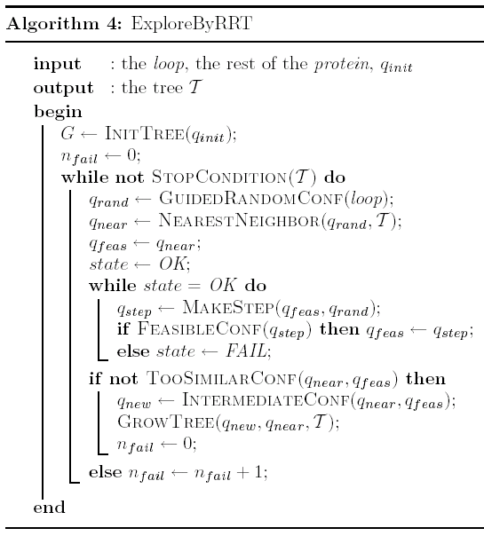
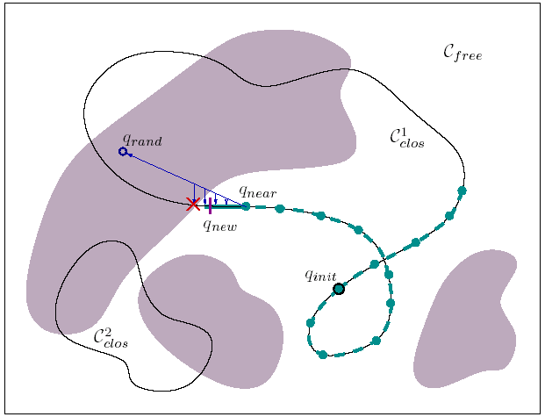
RTT Algorithm
Clash-Free conformation subspace
Conformations with clashes
Random conf. or from PDB
Sample qª
Linear Inter. and solving the closure eq. for q^{p}
Gaussian smpl
Conformations satisfying loop-closure
Believed to be an estimate to coverage

Slide 35
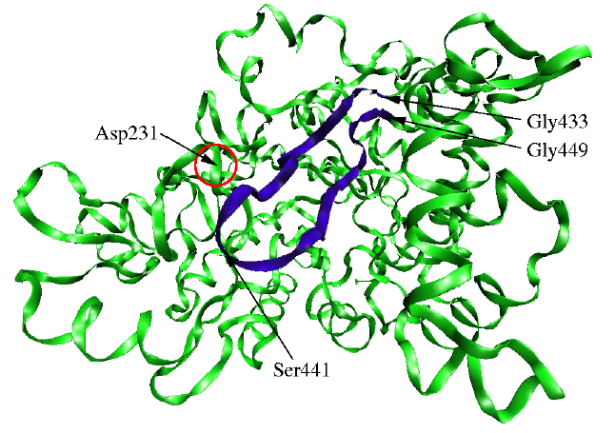
Results-structure of Amylosucrase
Motion of Loop 7 may have a pivotal rule in facilitating molecules interactions.
Loop 7

Slide 36
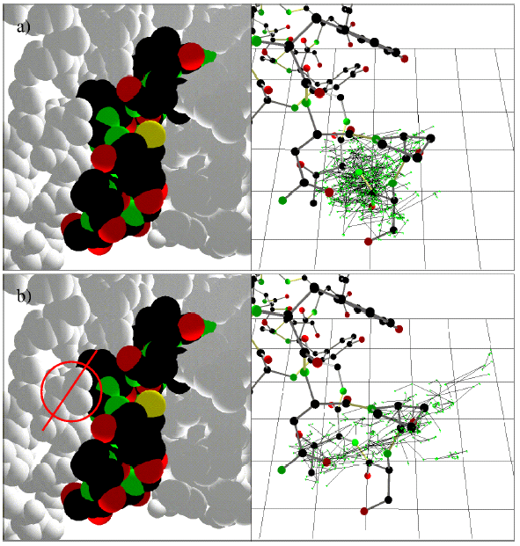
Results-exploration with/without side chain of Asp

Slide 37
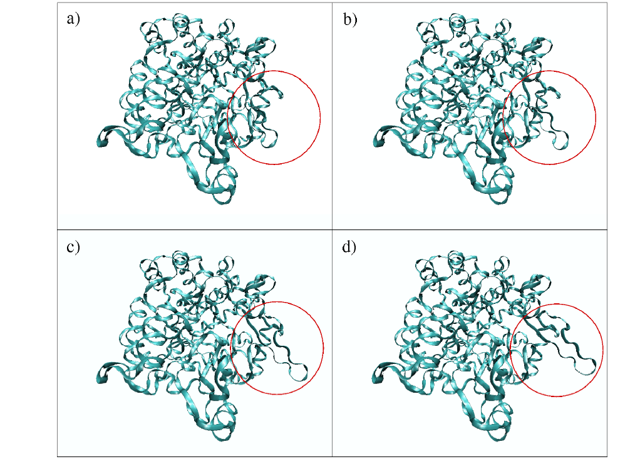
Results-simulated conformational change in loop 7

Slide 38
Conclusions
Filter technique for conformational sampling and search methods was proposed
Solution to the loop closing problem is computationally efficient
RLG computes exact closure solutions while CCD outputs approximated solutions

Slide 39
Prospects
Tailor a collision detection algorithm for the molecular application (Collision detection is by far the most computation expensive task)
Check clashes after each stage of RLG between backbone & static env.
Avoid steric clashes by choosing statistically preferred values for dihedral angles
Incorporate energetic analysis (constraints) into the incremental search technique

Slide 40
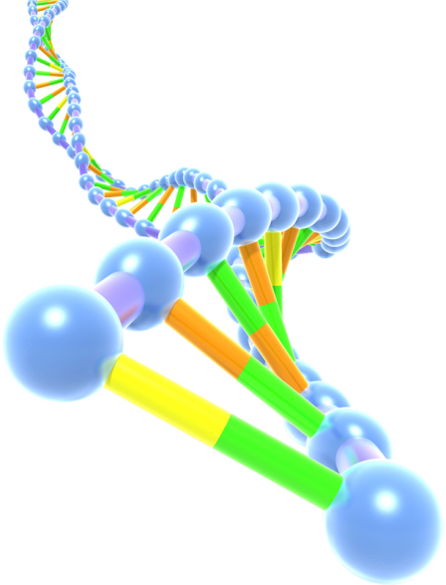
Questions ?

Slide 41
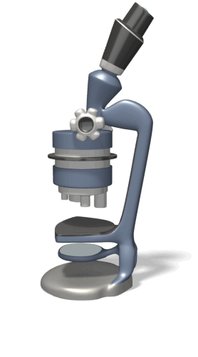
Thank You

Slide 42
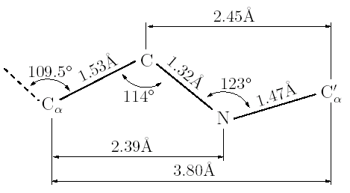
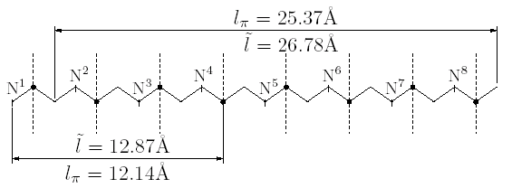
Polypeptide Extension (approximation)
l_{π} – length of polypeptide chain when all the dihedral angles at π.
Ĩ – upper bound on the chain’s length. It is the sum of the distances between consecutive C_{α} atoms.
The extension of a chain is randomly sampled from a distribution between l_{π} and Ĩ.

